Slide 1

ONE CLICK PICK
PROBLEM STATEMENT
In future the internet will become whole and soul to the business fields, each and every trades are going to be done through it. The main concern is given to the village seller’s to explore and enhance their business.

Slide 2
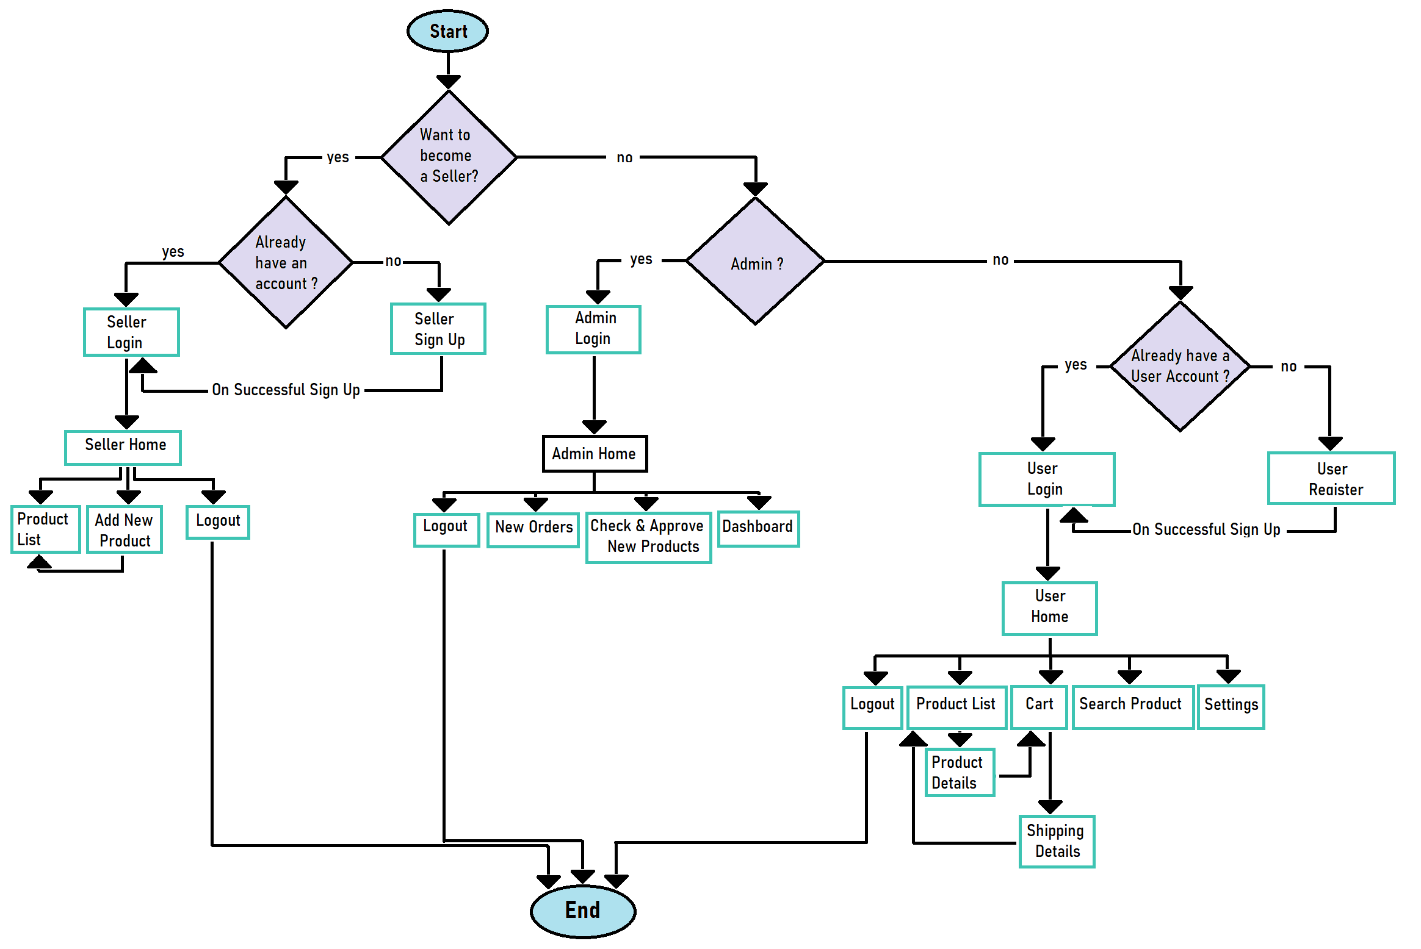
Flowchart

Slide 3
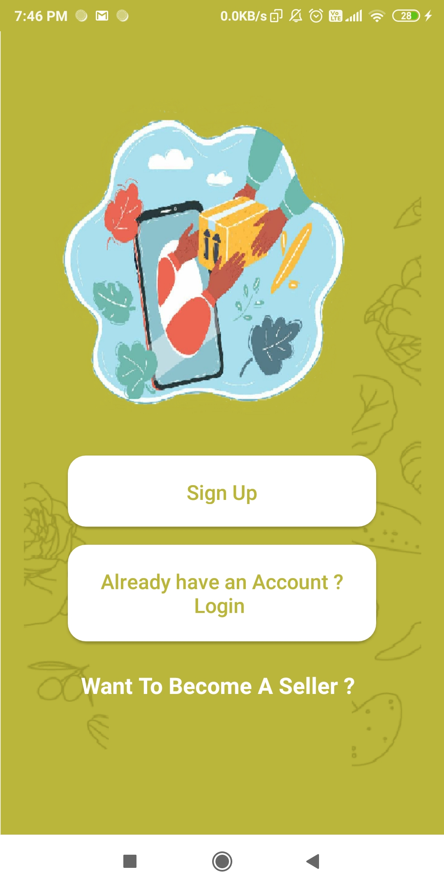
Types of Users :
✔ Consumers ✔ Admin ✔ Sellers

Slide 4
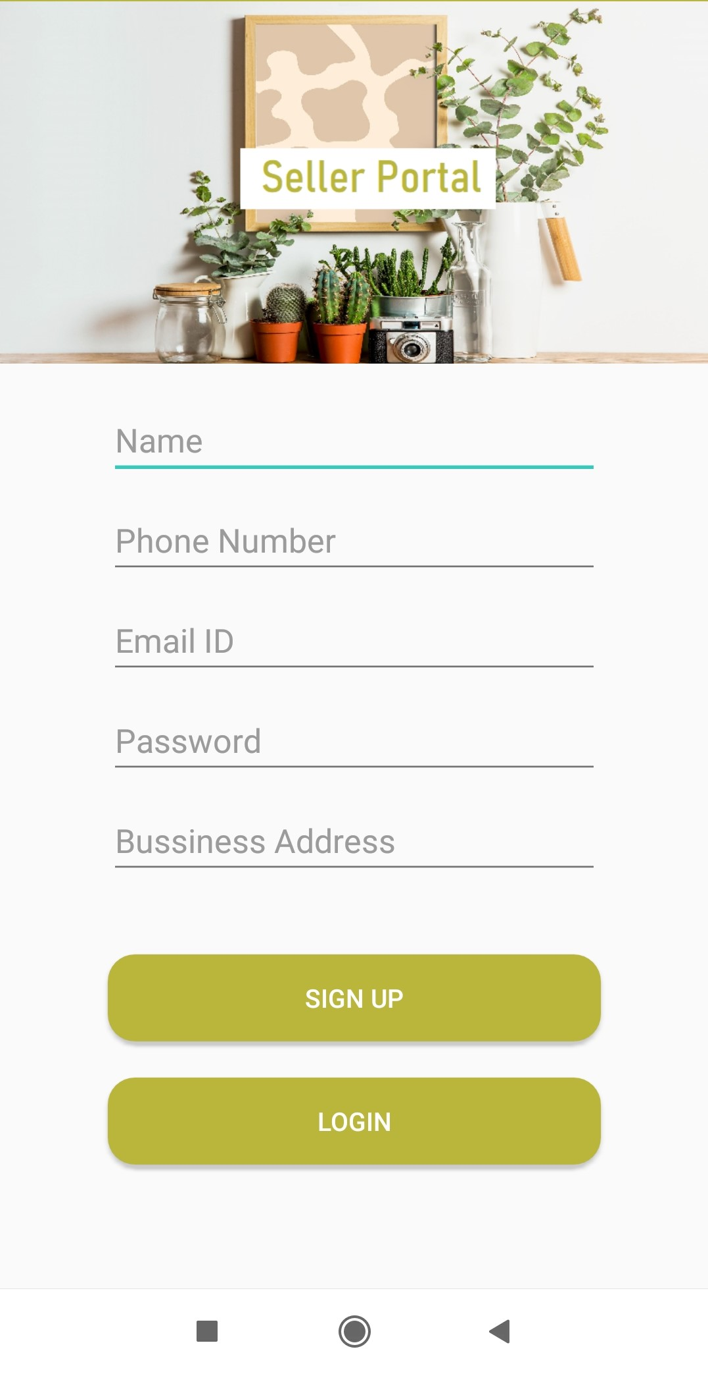
Seller Sign Up

Slide 5
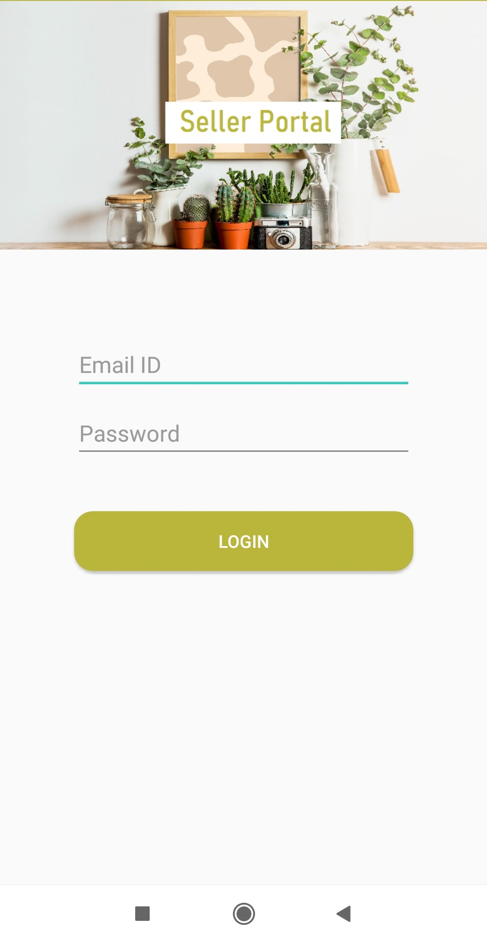
Seller Login

Slide 6
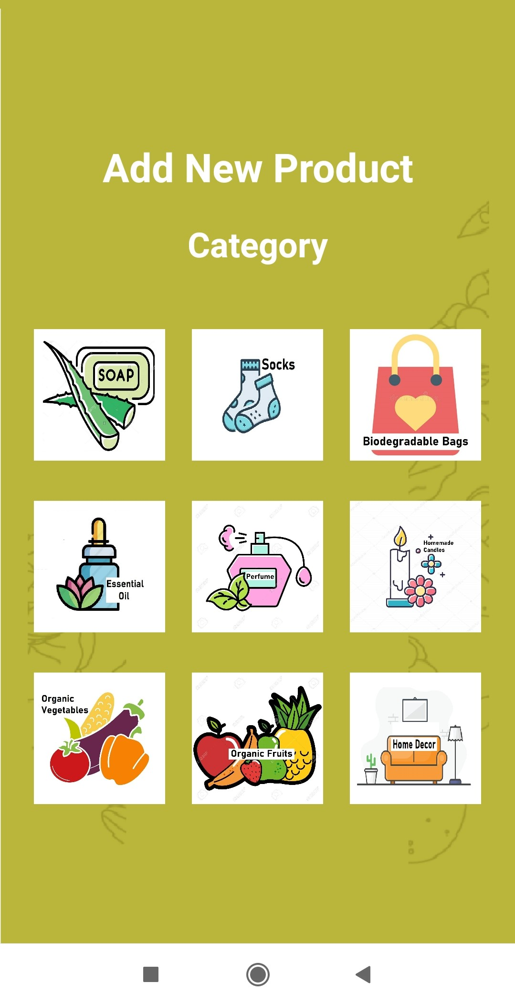
Product Category

Slide 7
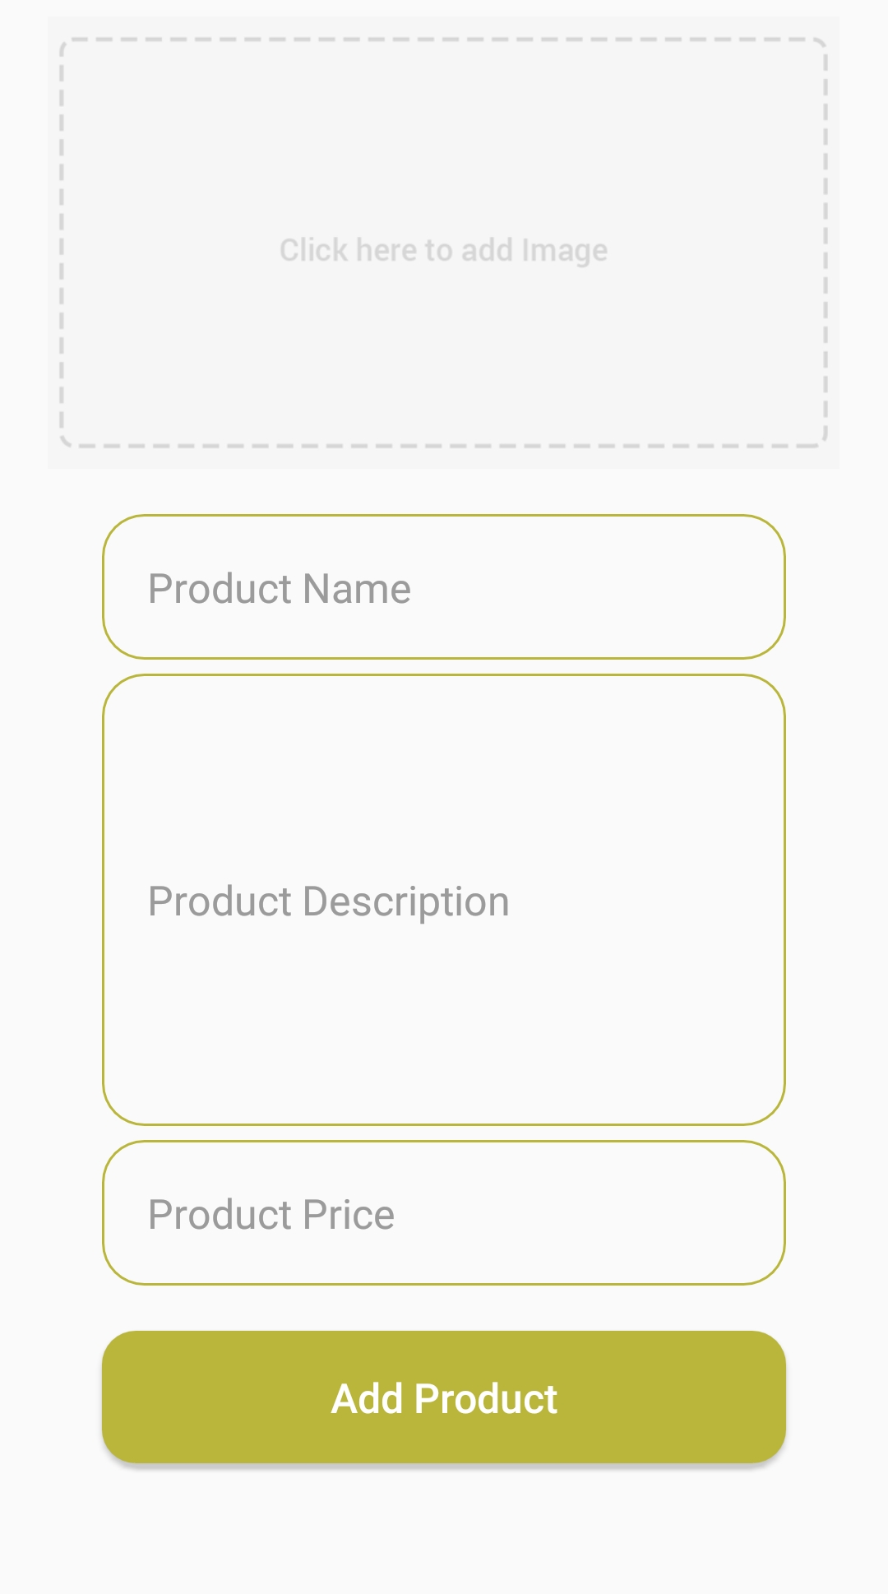
Add New Product

Slide 8
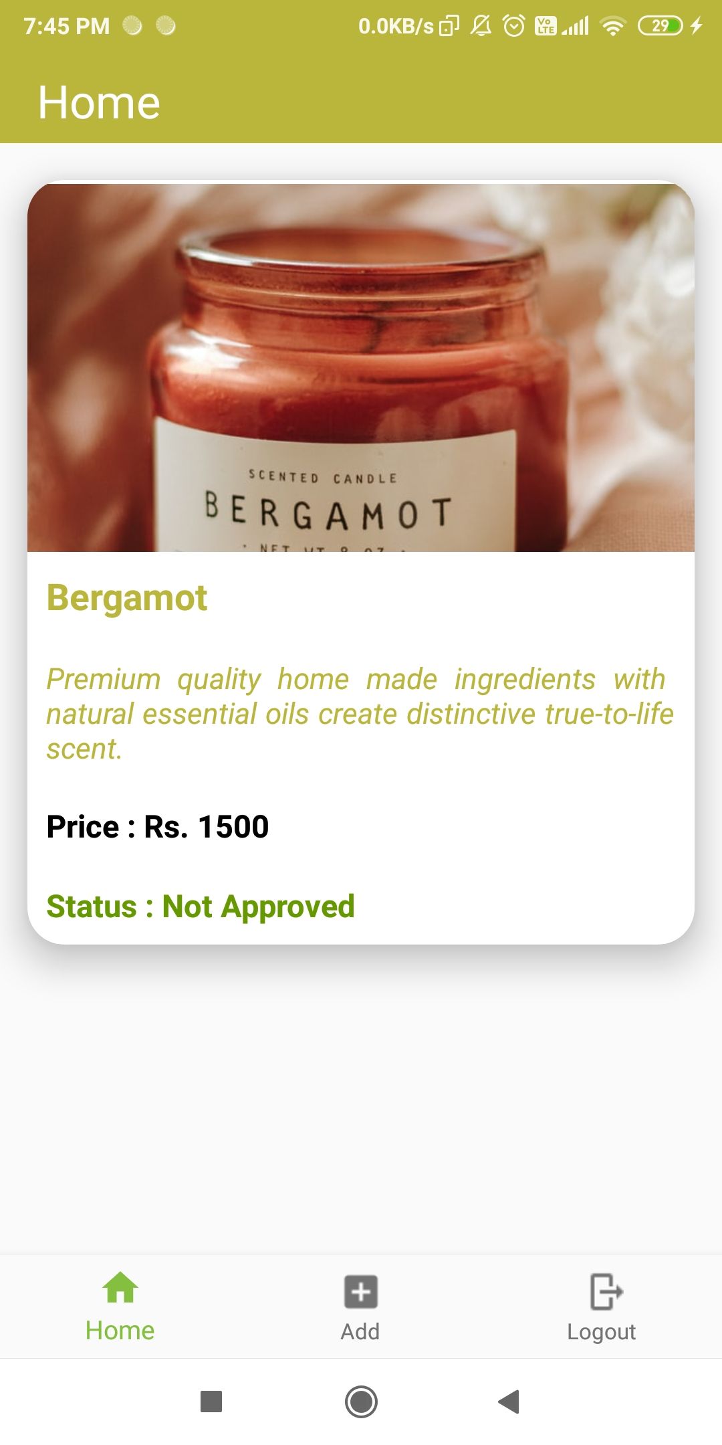
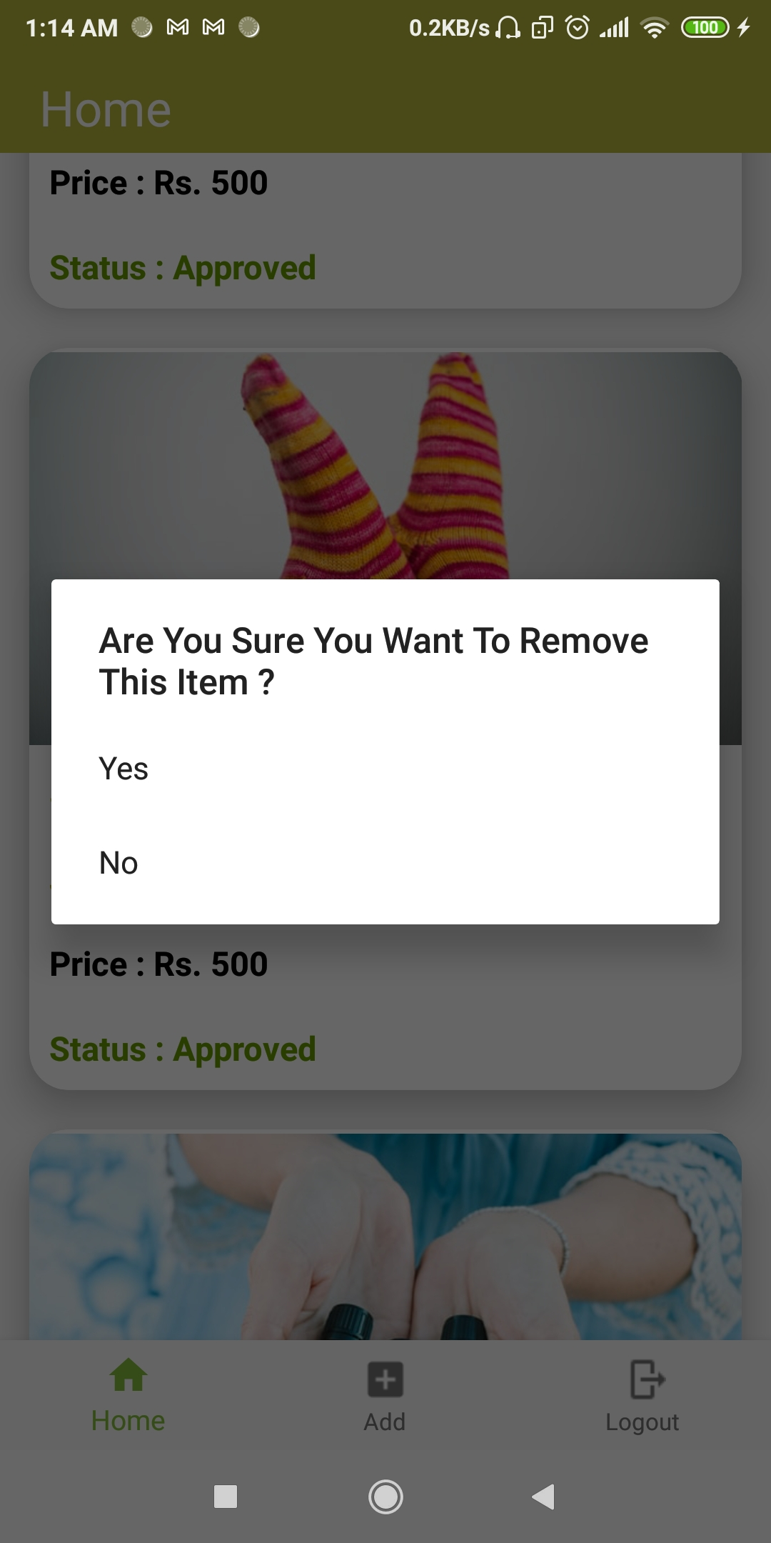
Seller Home
List Of Products Added By The Seller.

Slide 9
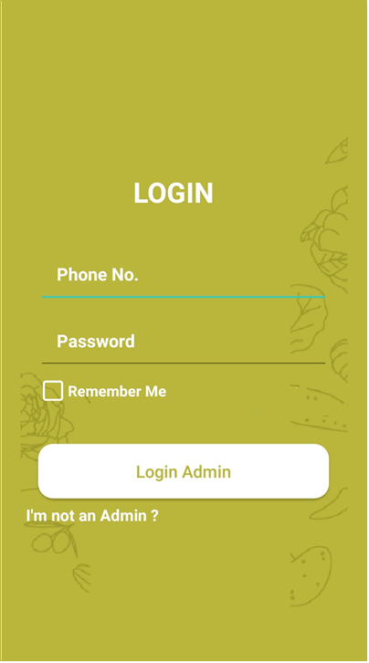
Admin login

Slide 10
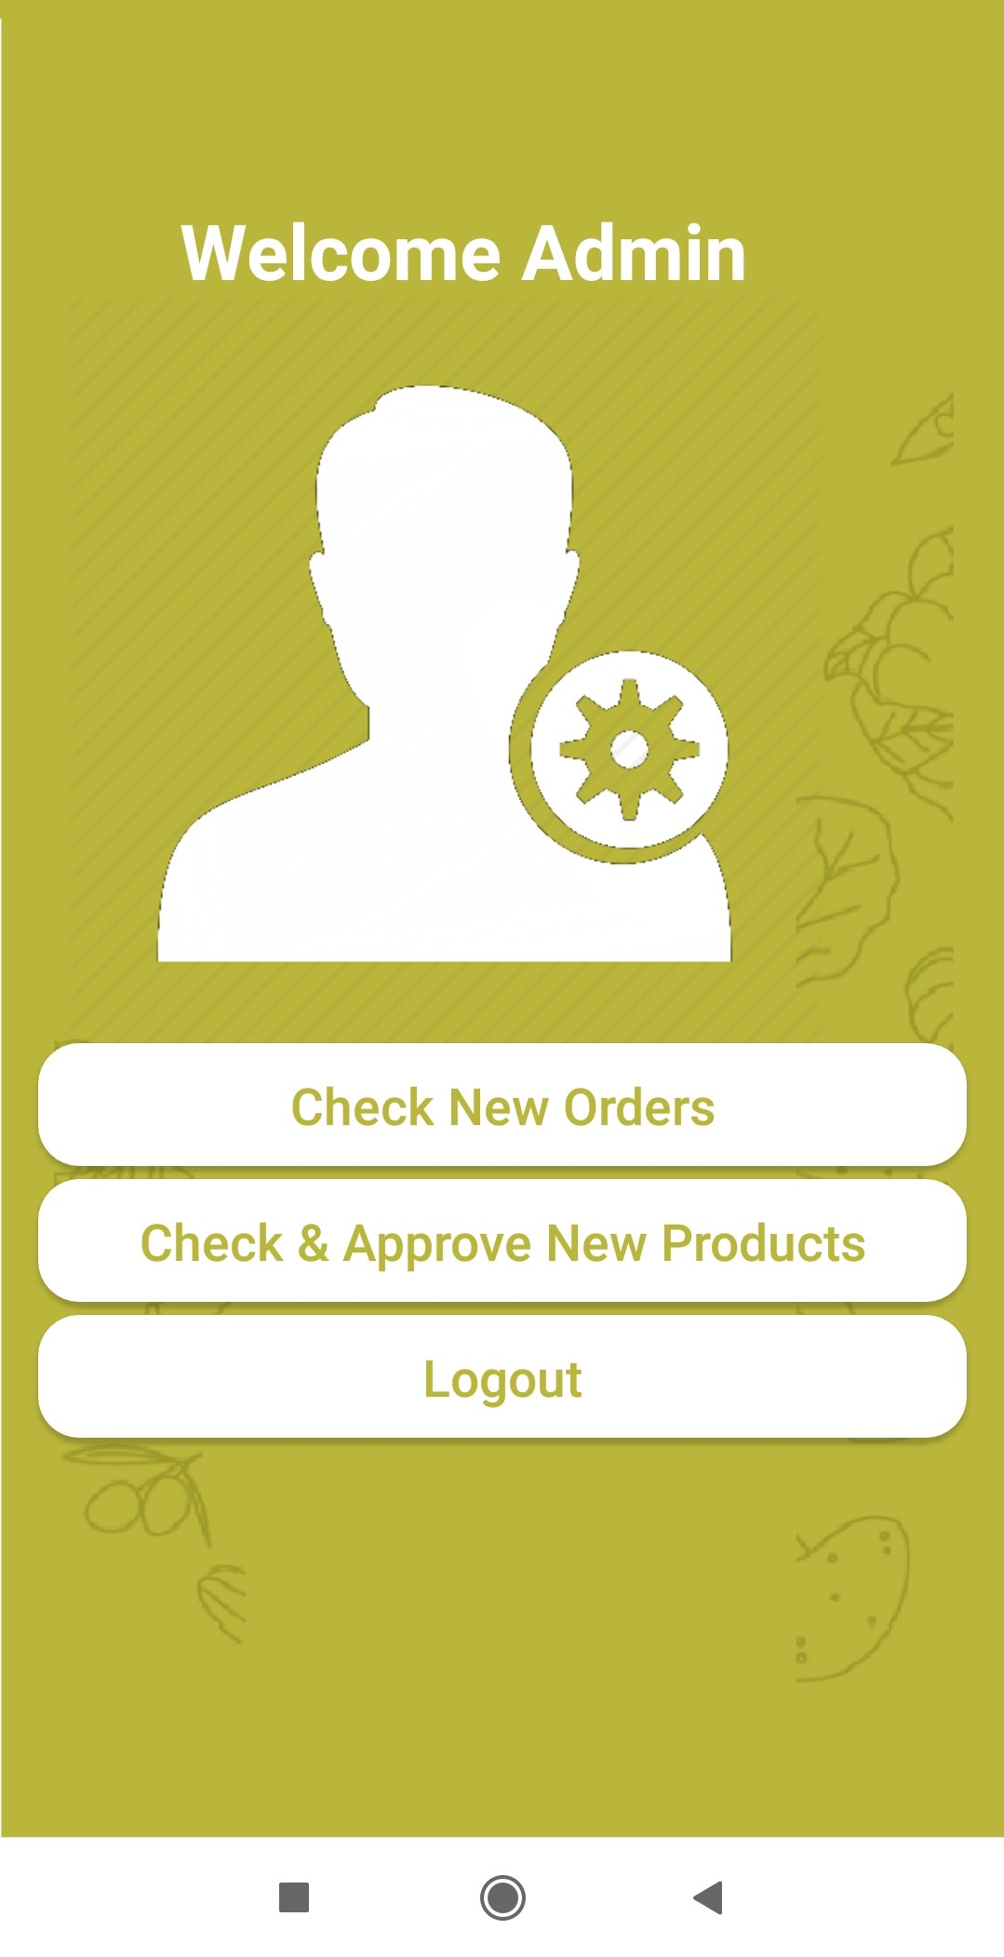
Admin Home

Slide 11
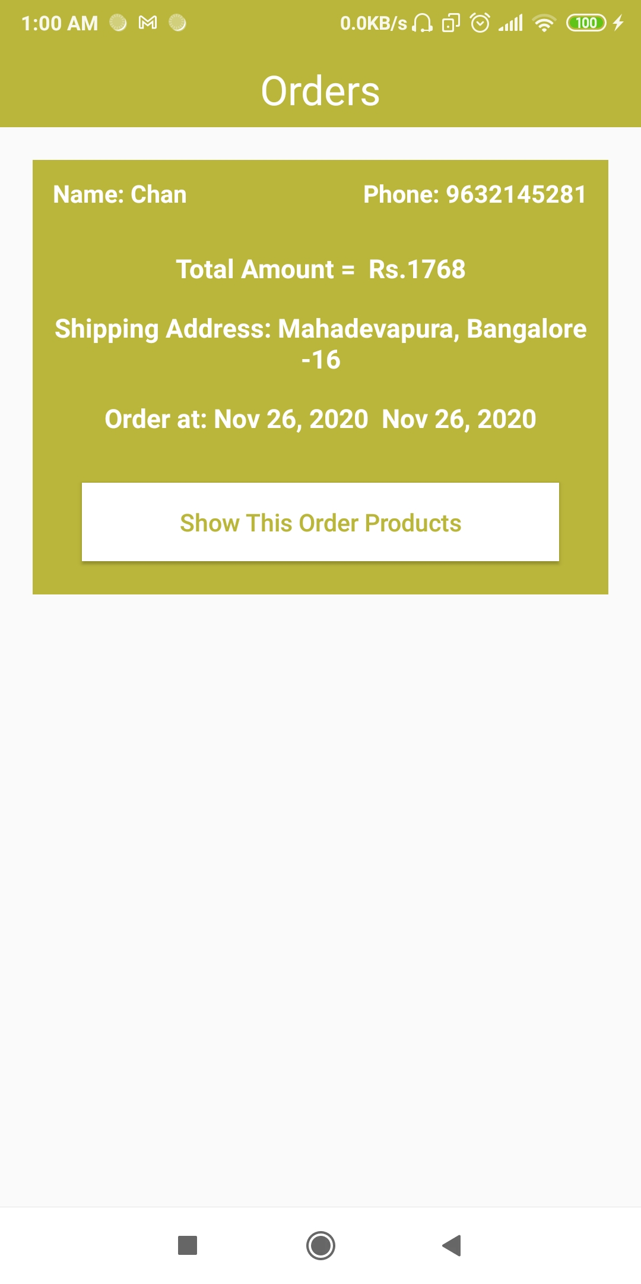
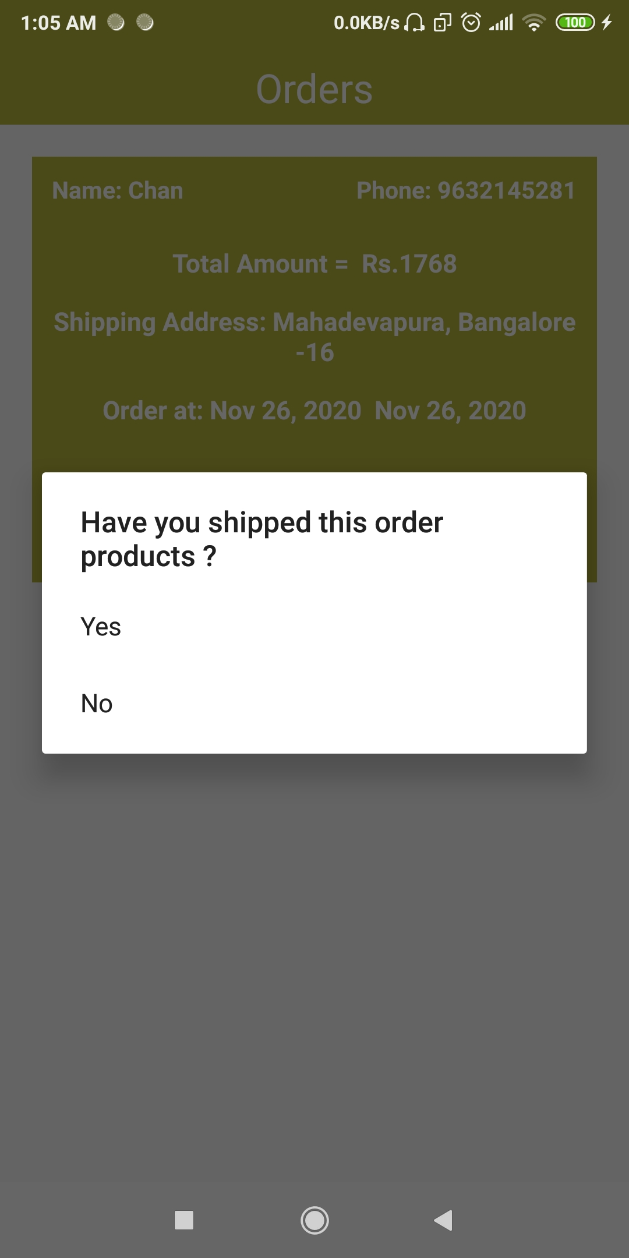
New Orders Placed By The Consumer

Slide 12
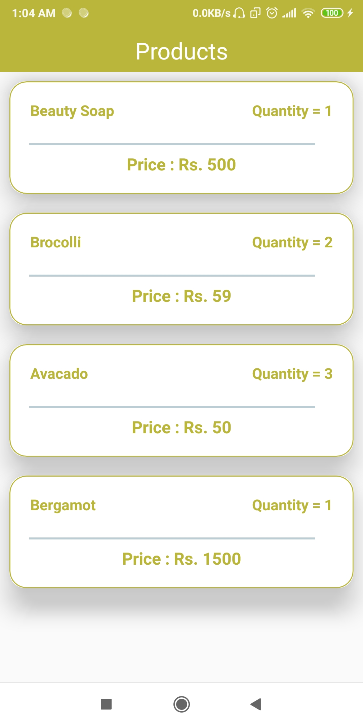
Ordered Products From The Order Placed By The Consumer

Slide 13
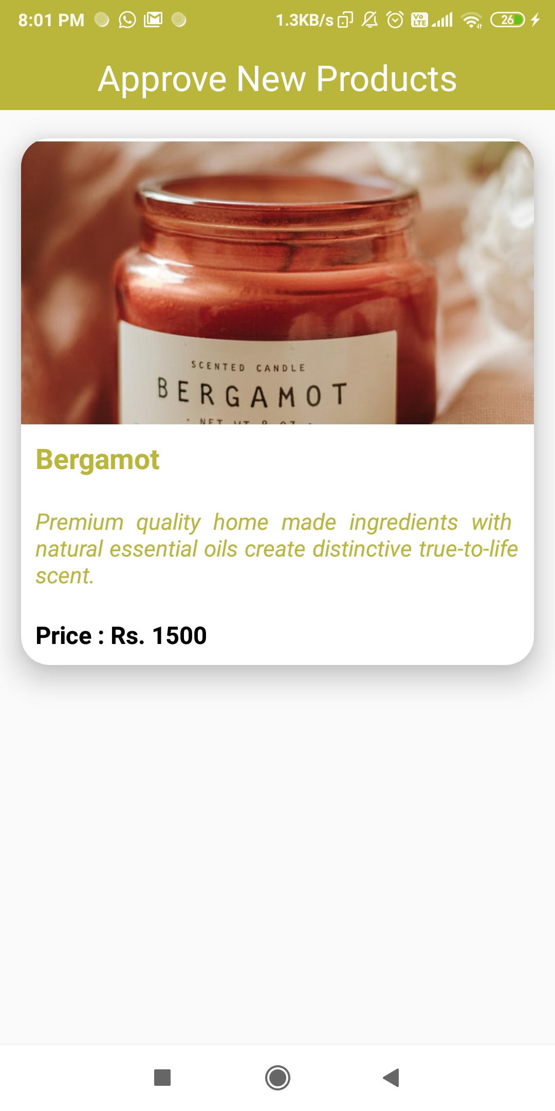
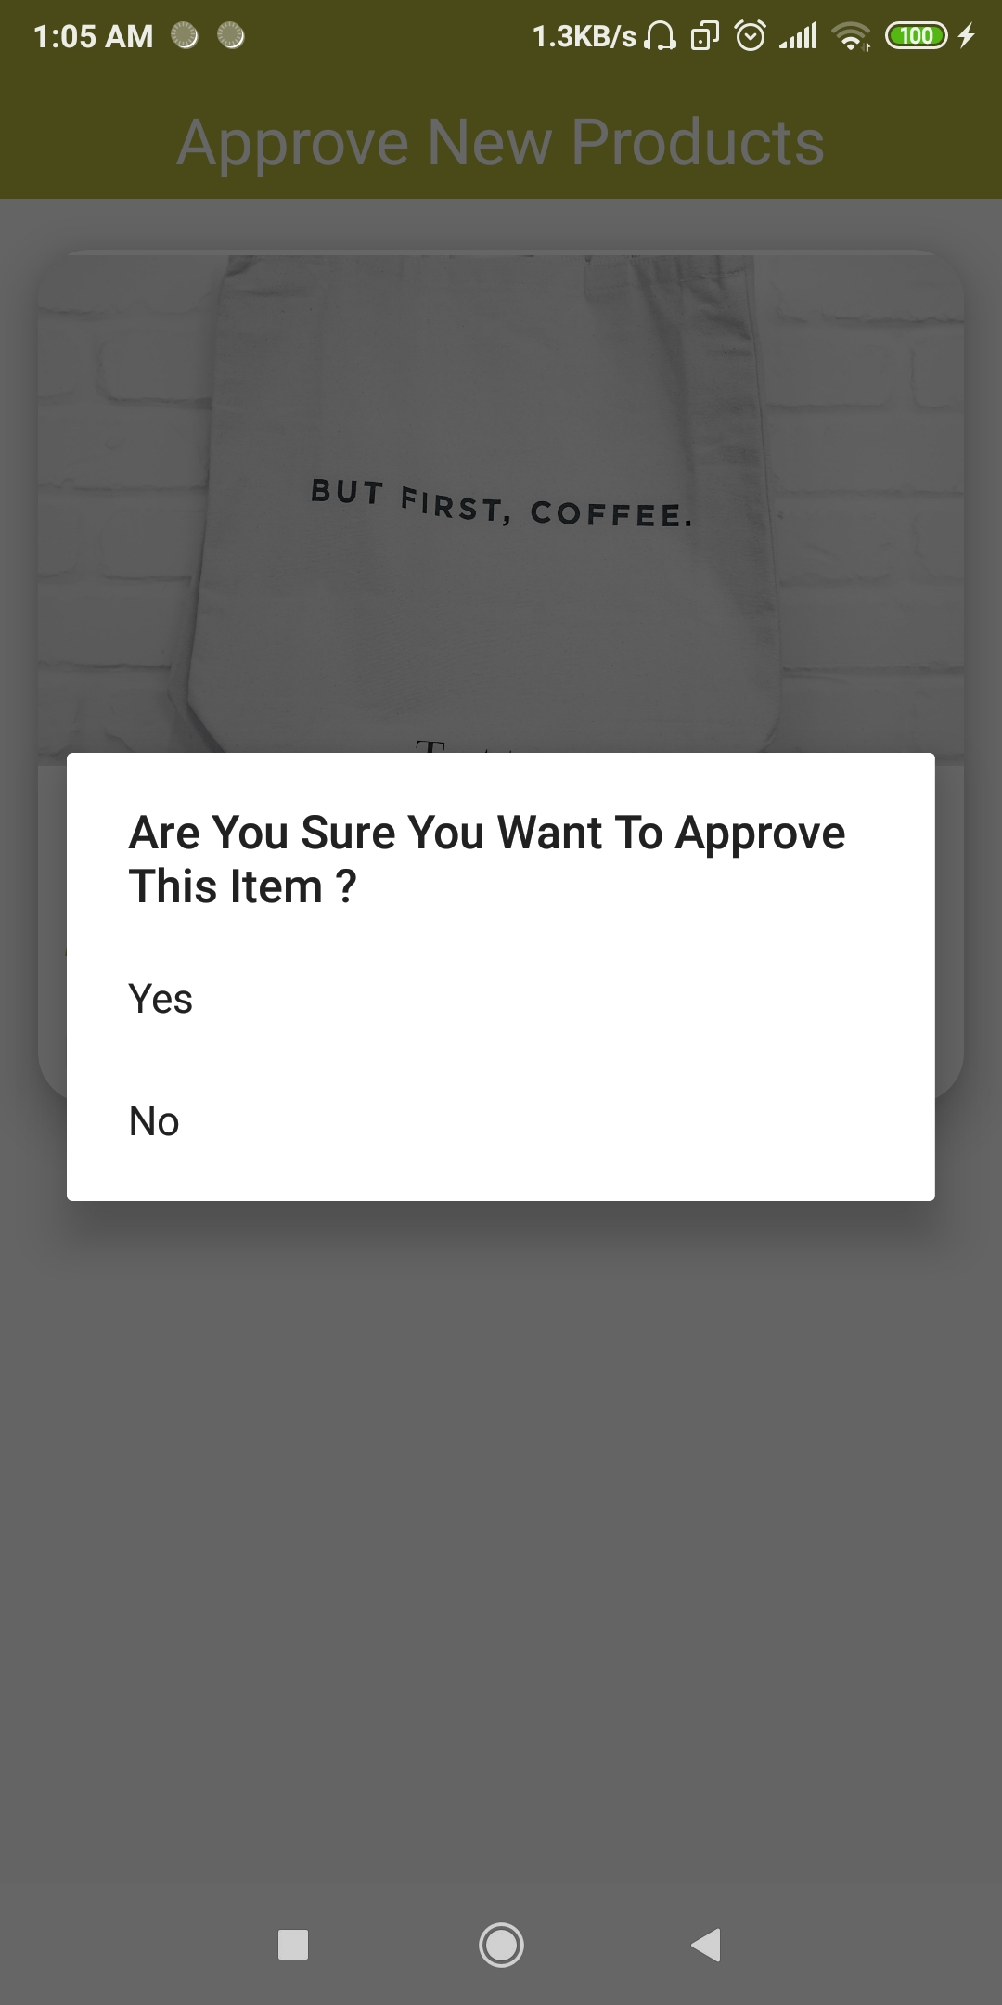
Check & Approve New Products Added By The Sellers

Slide 14
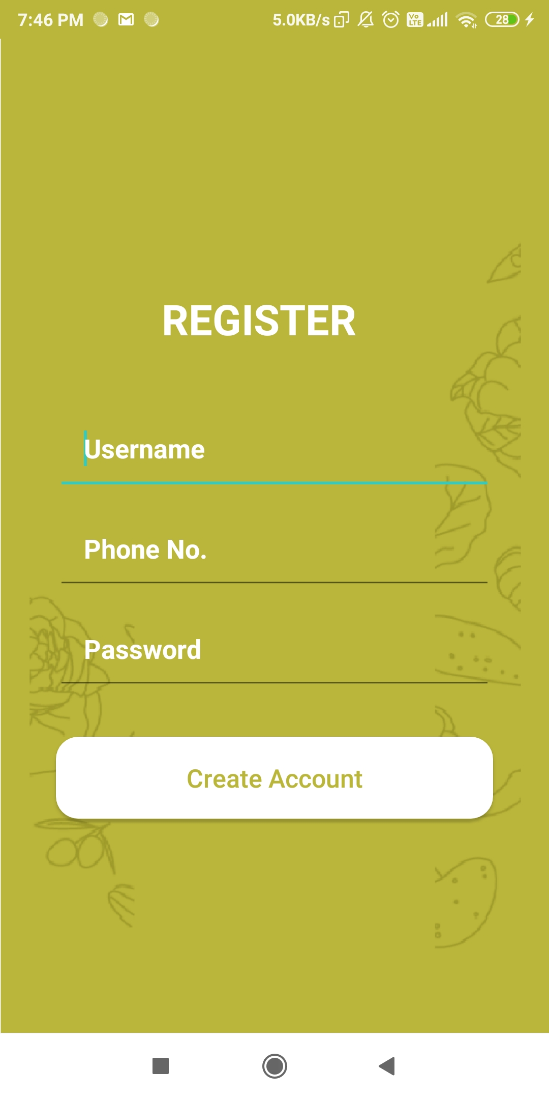
Consumer’s Sign Up

Slide 15
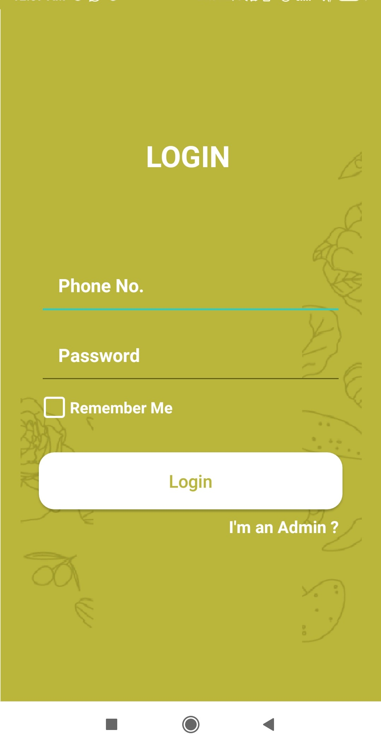
Consumer’s Login

Slide 16
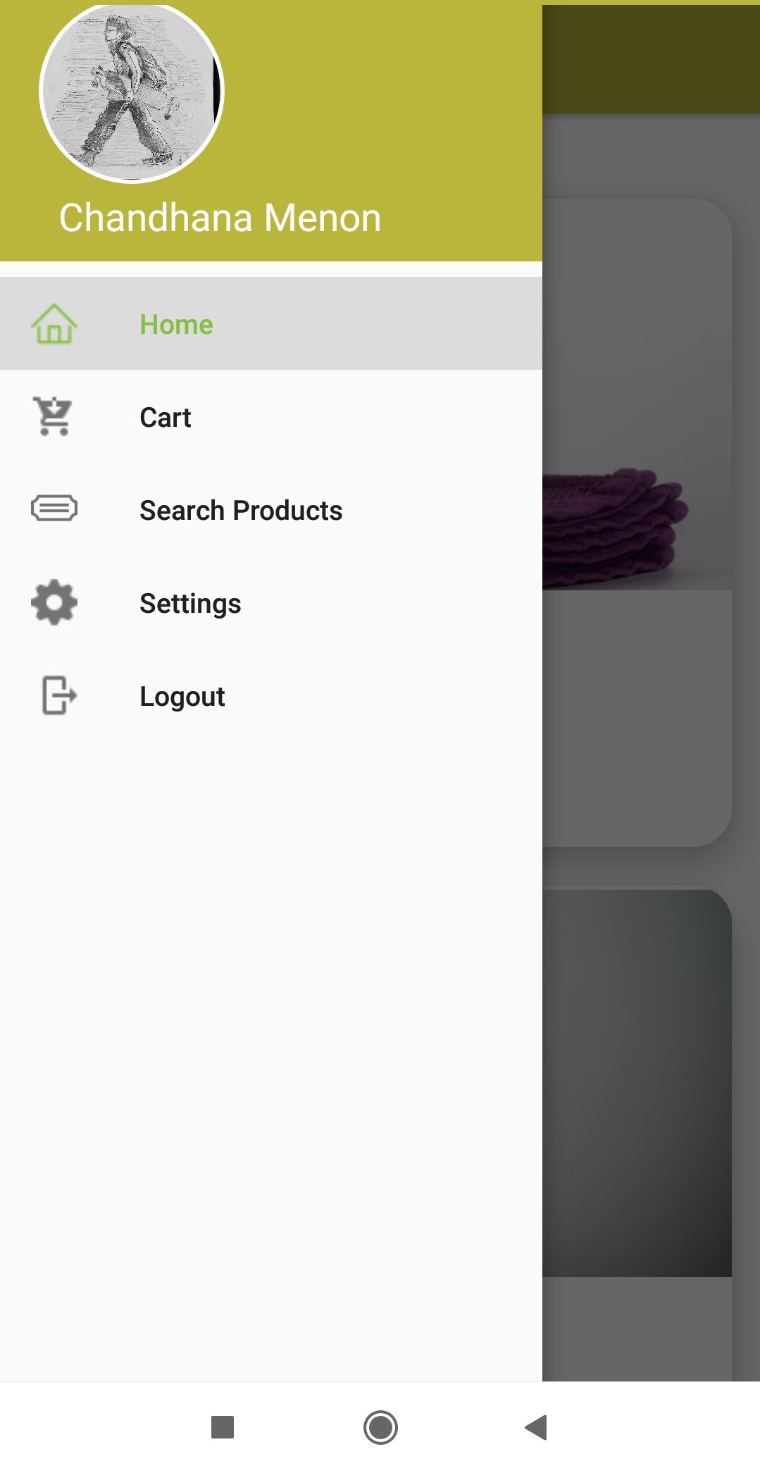
Consumer’s Navigation Drawer

Slide 17
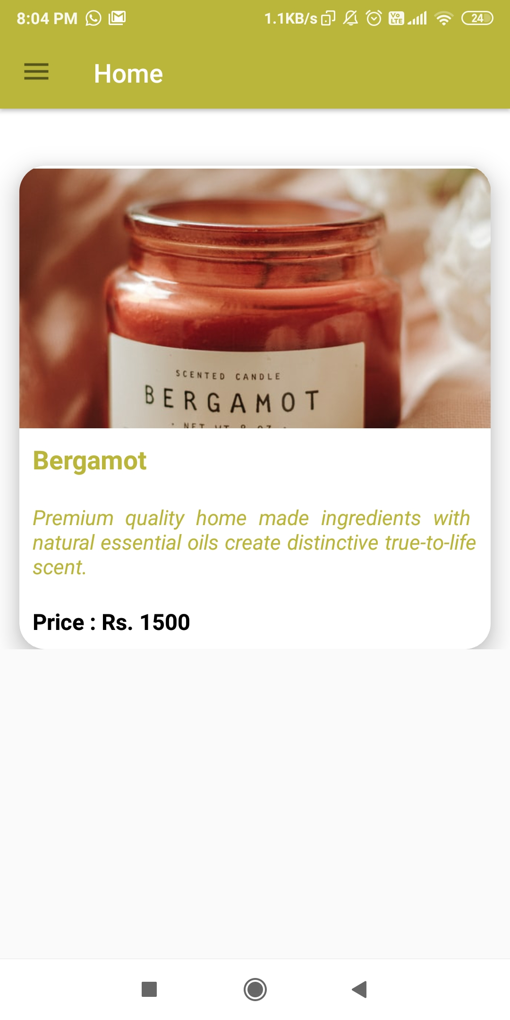
Consumer’s Home
List Of Products Added By The Seller That The Admin Has Approved Of.

Slide 18
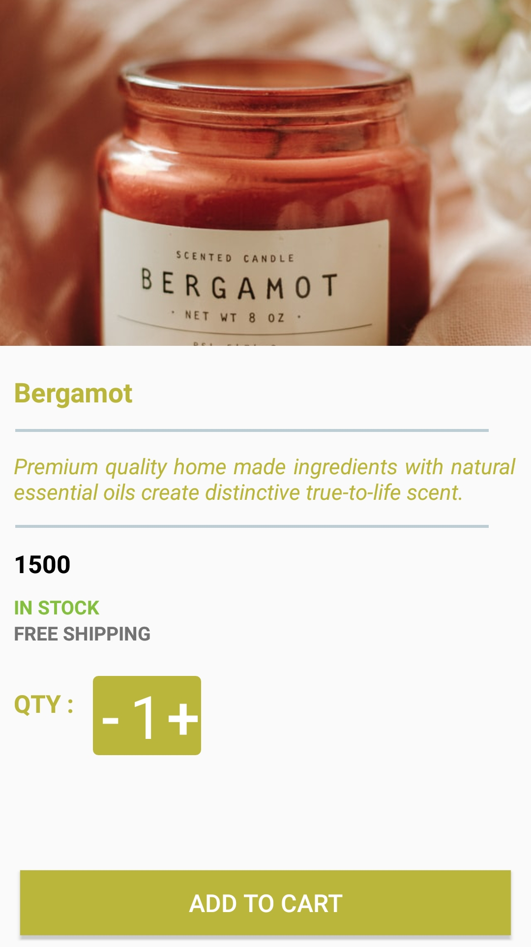
Product Details

Slide 19
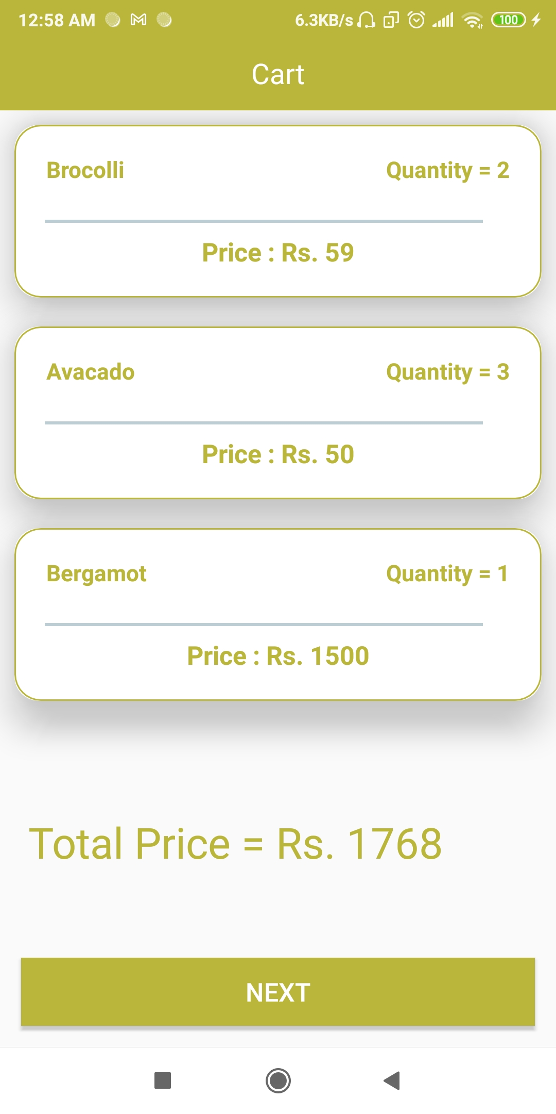
Consumer’s Cart

Slide 20
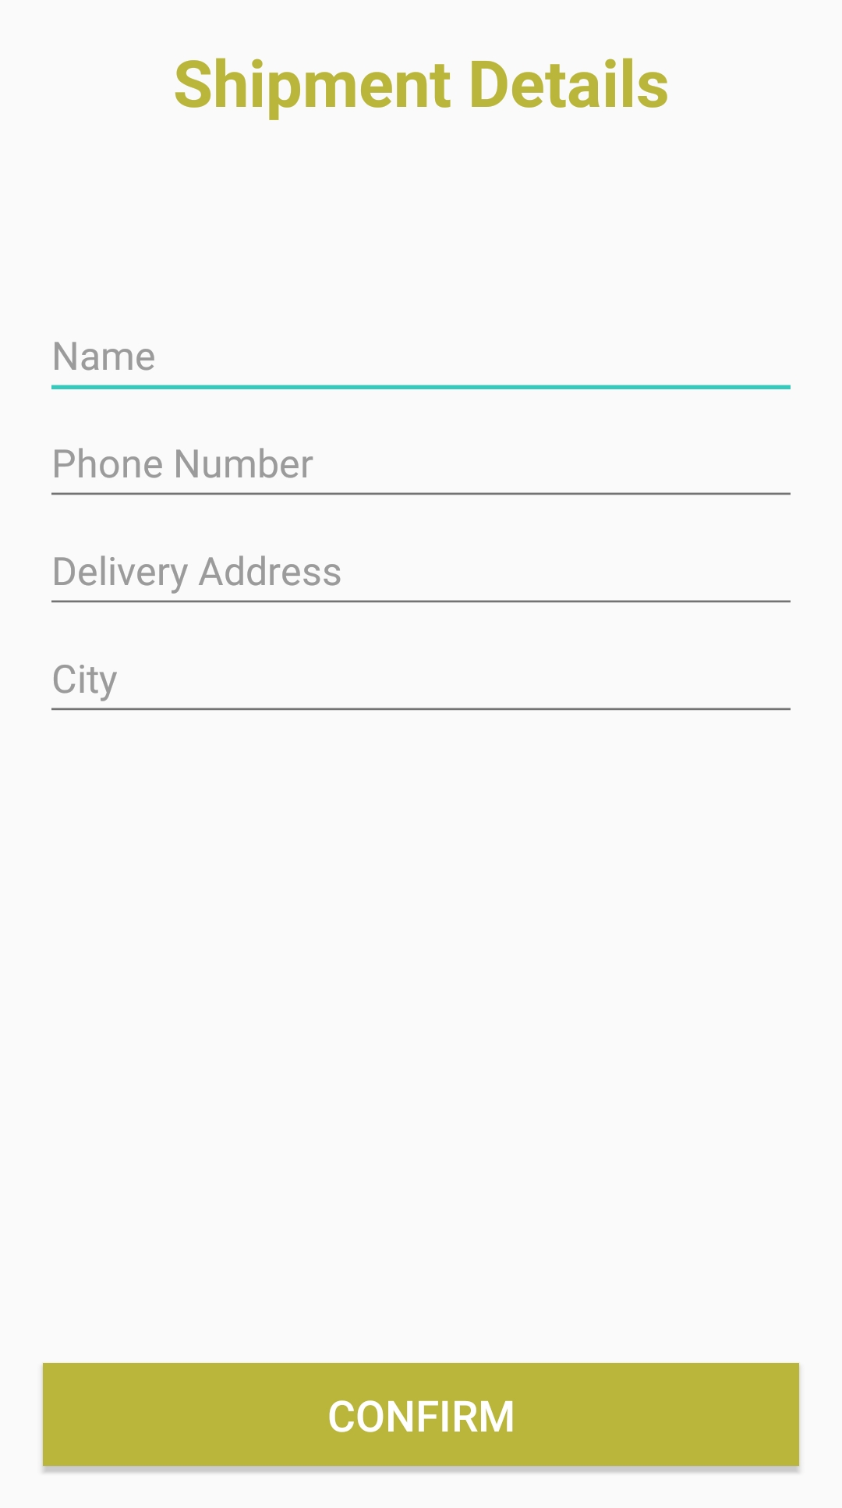
Consumer’s Shipment Details

Slide 21
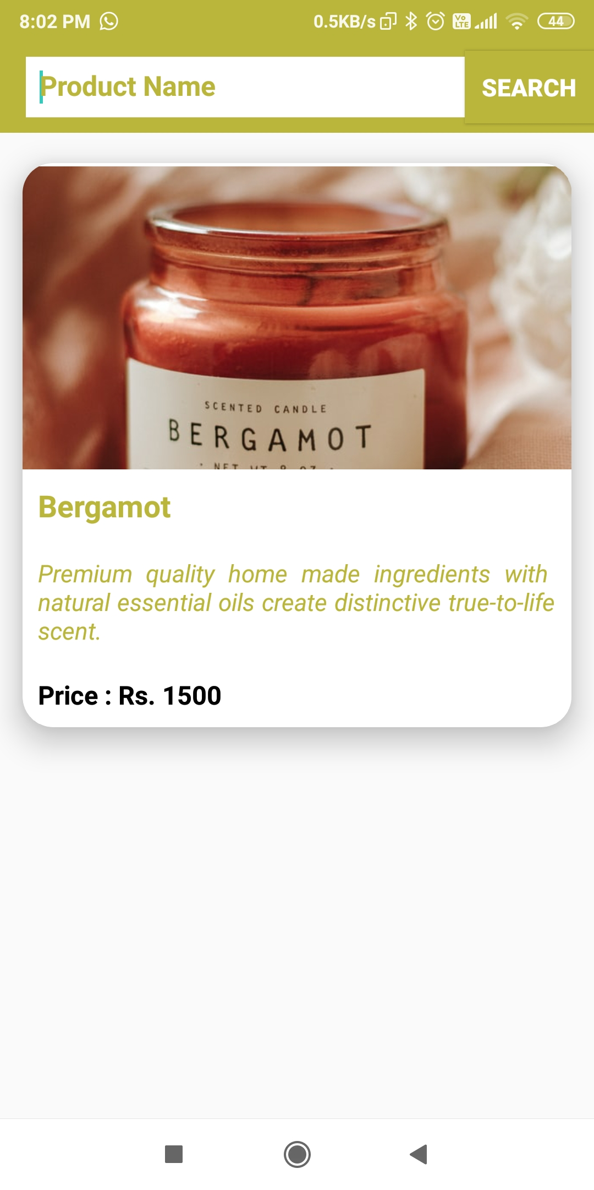
Search Products

Slide 22
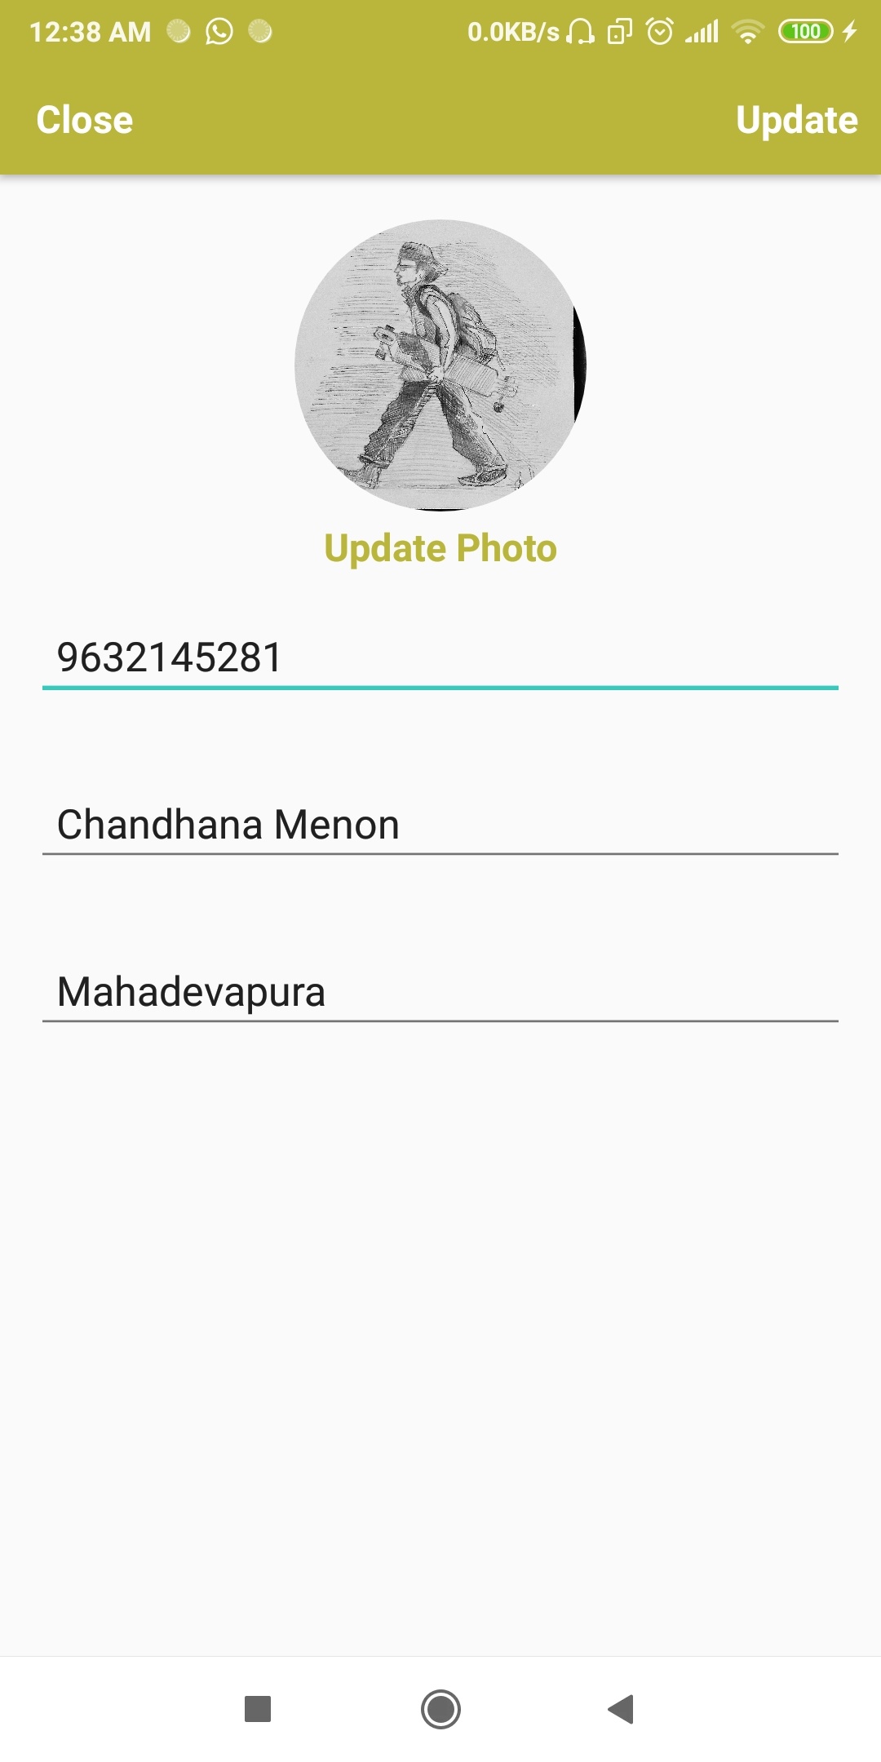
Consumer’s Settings

Slide 23
Thank you

